Slide 1


xAPI LAUNCH
Notes:
Stop hardcoding configuration

Slide 2
Q: How does the content know the identity of the user, and the address of the Learning Record Store (LRS)?
Notes:
In most of the examples you’ve seen so far, we’ve glossed over a huge and important step
How does the content know the identity of the user, and the address of the Learning Record Store (LRS) ?

Slide 3
Q: How does the content know the identity of the user, and the address of the Learning Record Store (LRS)?
A:
Hard code the content to directly include an identity of the user, and the LRS endpoint and credentials
Prompt the user
“I just logged in, why is it asking me again?”
Exposes the LRS credential for every user
to see - they could even manually post
Statementto claim they passed.
Make up some other method
Notes:
In most of the examples you’ve seen so far, we’ve glossed over a huge and important step
How does the content know the identity of the user, and the address of the Learning Record Store (LRS) ?
“I just logged in, why is it asking me again?”
Hard to make course content portable or reusable

Slide 4

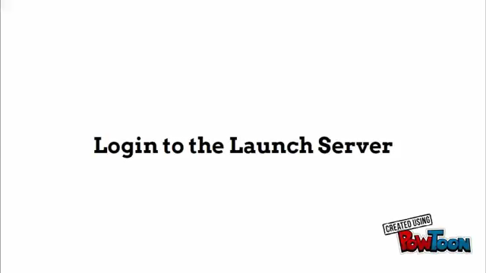
Notes:
Launch provides a way for a user to grant temporary access to his or her LRS without exposing their credential to the content.
It also enforces a concept of a “session” on xAPI experiences.
Launch includes a mechanism to prevent the user from directly posting to their own LRS during a “session”
Using xAPI Launch, neither the user's identity nor their LRS credentials need be included in the content
The users’ LRS endpoint and password are never shared with the content
Statements from the content are automatically grouped into a session
The content has limited access to the LRS.
The content can be configured with custom launch parameters.
When paired with an optional cryptographic key, students cannot manually insert statements into a session, even when they have access to their own LRS

Slide 5
Q: What does Launch accomplish?
A:
Using xAPI Launch, neither the user's identity nor their LRS credentials need be included in the content
The users’ LRS endpoint and password are never shared with the content
Statements from the content are automatically grouped into a session.
limited access to the LRS
can have custom launch parameters
optional cryptographic key (student proof)
Notes:
Using xAPI Launch, neither the user's identity nor their LRS credentials need be included in the content
The users’ LRS endpoint and password are never shared with the content
Statements from the content are automatically grouped into a session
The content has limited access to the LRS.
The content can be configured with custom launch parameters.
When paired with an optional cryptographic key, students cannot manually insert statements into a session, even when they have access to their own LRS

Slide 6
Enabling Launch in your Content

Slide 7
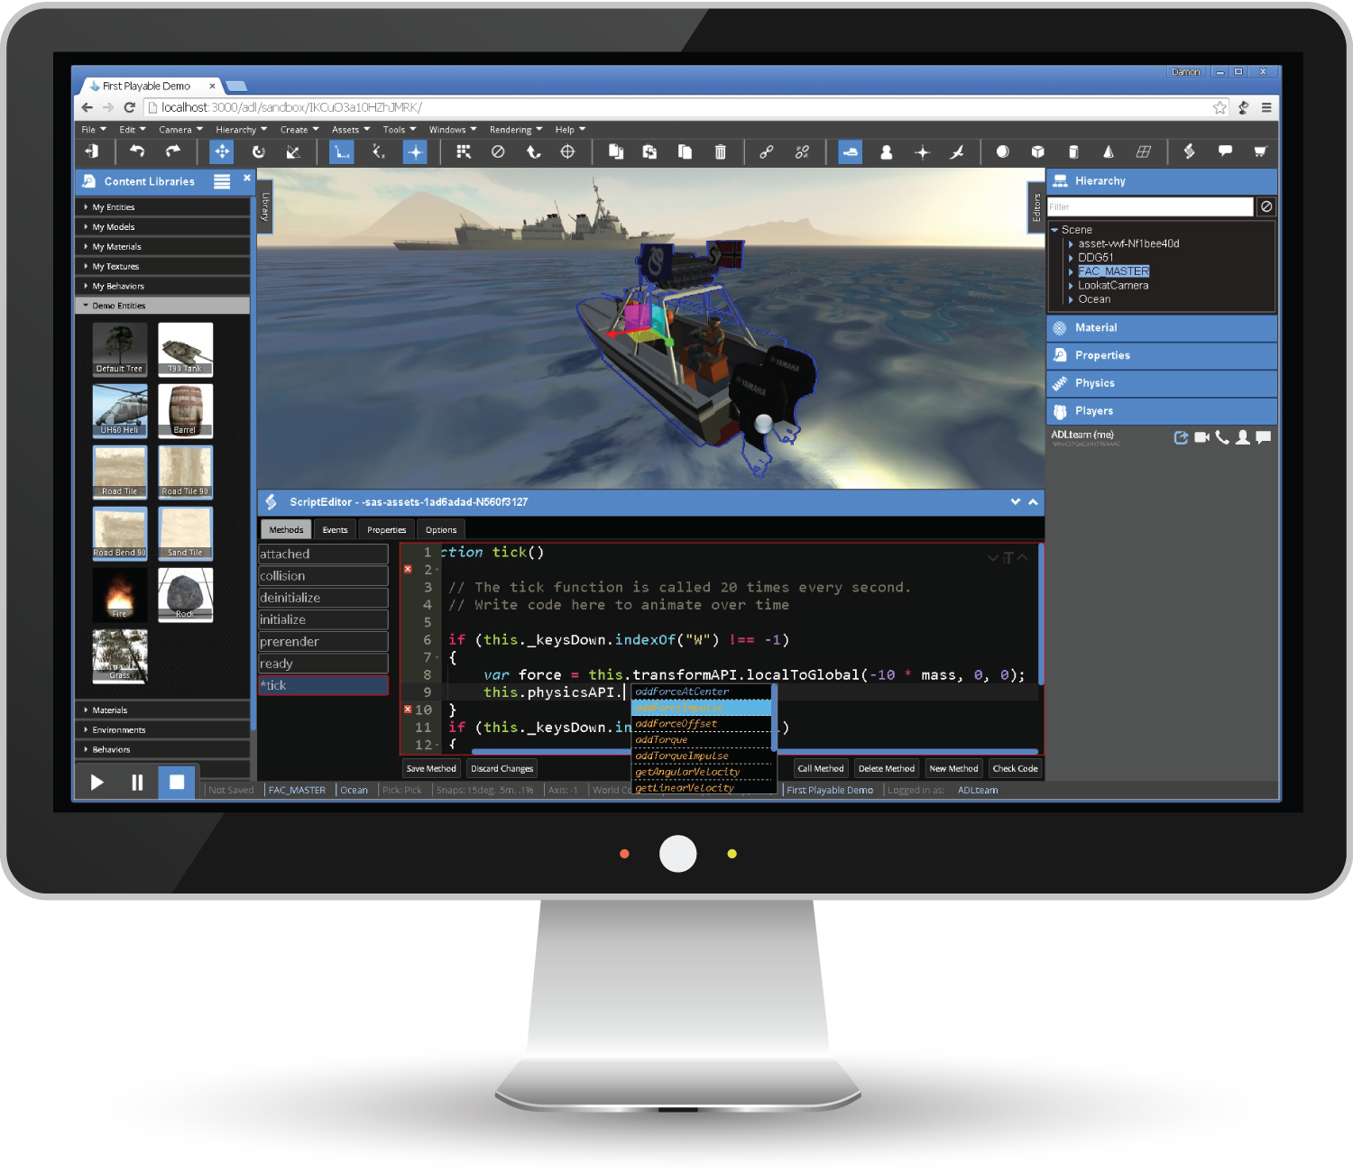

ADL.launch(
function(err,apiData,xAPI){
if(err)
{
$('#apiData').text(err)
}
else
{
$('#apiData').text(JSON.stringify(apiData))
var t = new ADL.XAPIStatement(...);
xAPI.sendStatement(t);
}
},false
)
Notes:
If you’re already using ADLs xAPIWrapper.js, you’re halfway there.

Slide 8
Q: What Data do you get?
A:
Err
A string error can
if there was a problem null if
all is well.
apiData
A structure containing
Configuration.
xAPI
An instance of
the xAPI Wrapper that is already configured to talk to the proper endpoint.
Notes:
Err
A string error code if there was a problem,
null if all is well
apiData
A structure containing configuration information
xAPI
An instance of the xAPI Wrapper that is already configured to talk to the proper endpoint

Slide 9

Actor
Endpoint
Context Activities
Custom Data
Session Length
Initialization Code
Notes:
Actor
An identity of the user on the launching server
Endpoint
The temporary xAPI endpoint for this session
Context Activities
Grouping - The content record from the server
Parent - The specific launched session of this user on this content
Custom Data
Per Launch session data
Course configuration data
Session Length
How long until the session automatically closes?
Initialization Code
Has the user refreshed this page, or is this launch part of a multipage experience?

Slide 10
Using the
Launch Server

Slide 11
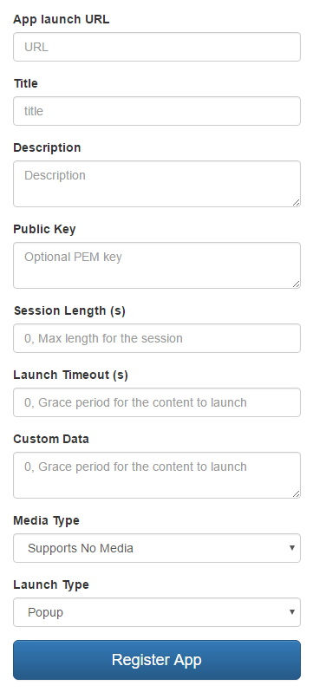
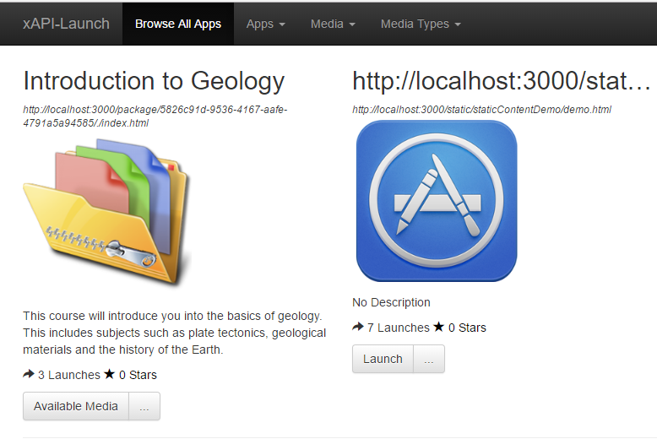
Notes:
What can you do?
Enroll a link
Upload a package
Check launch history
See statements for each launch
A content URL must be added to the launch server before it can be launched.
The launch server uses the term “App” to refer to a single learning experience

Slide 12
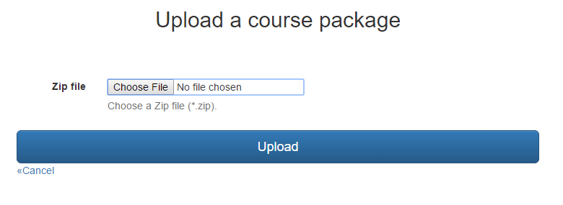

Notes:
The Launch server can also host content for you.
When you upload a zip file, we’ll create an app record based on the included manifest.

Slide 13
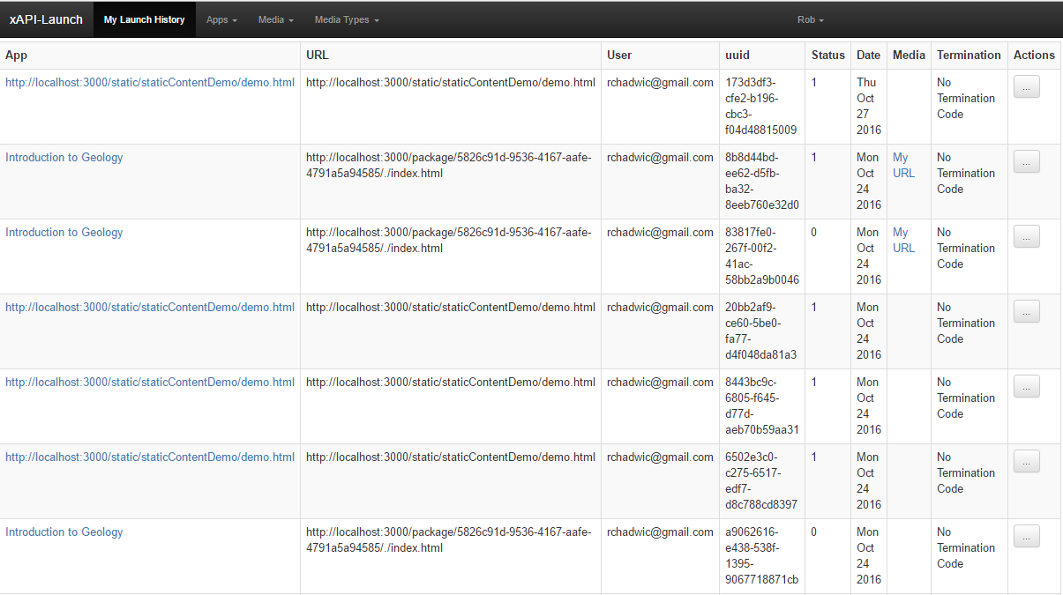

Notes:
You can view all the sessions you’ve Launched.

Slide 14
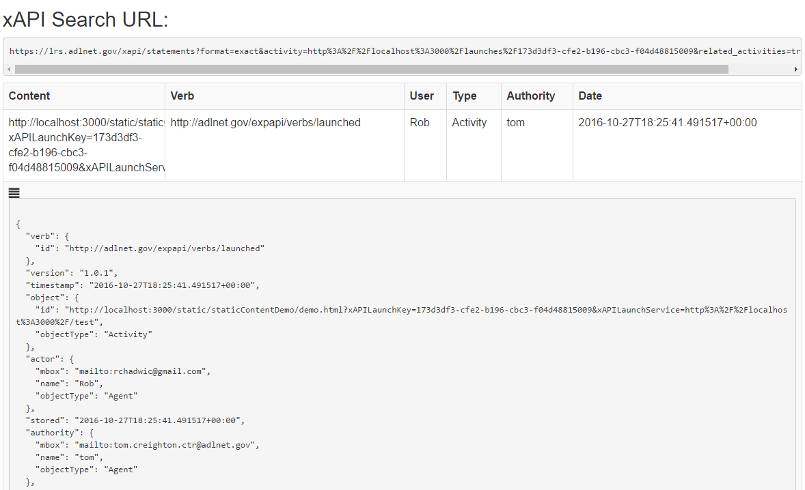

Notes:
You can view all the xAPI Statements that belong to a given session.

Slide 15
Use xAPI Launch to Protect your users,
Your data, and your LRS.

